Slide 1
Data Analytics
Incident Management
Final
Josiah Vincent

Slide 2
Goal
Analyze the Incident Management data from the company that I work and pay close attention to how long it is taking to resolve incidents.
I am looking to see if when they use knowledge articles if it is having any kind of impact on the resolution time.
Produce a clean looking and easy to use interactive dashboard that would show the usefulness of knowledge articles when resolving an incident.

Slide 3
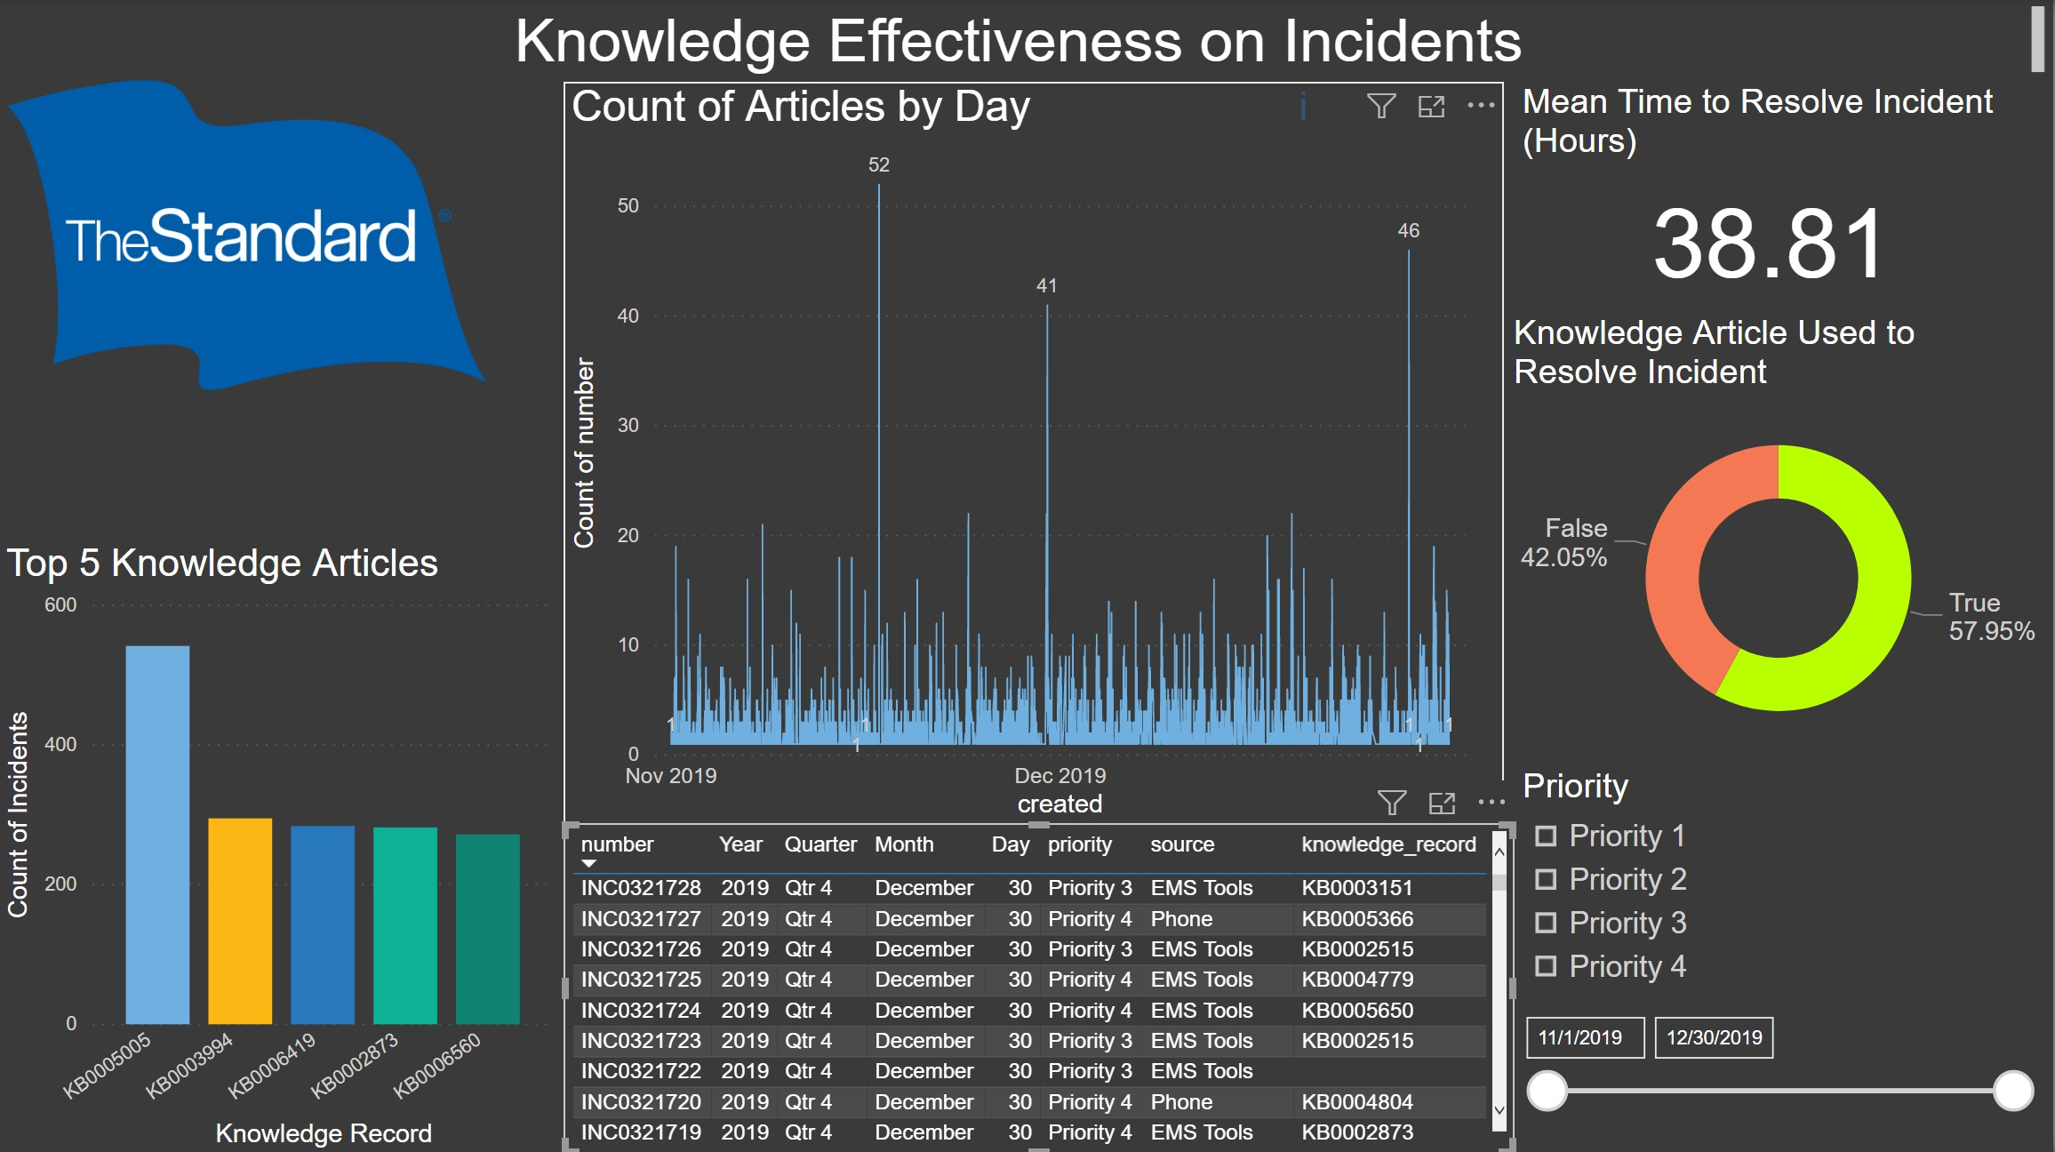
Dashboard Walkthrough
General
Everything is interactive so if I select any piece of data from any of the visualizations on the dashboard the rest will update to reflect what you are looking at.

Slide 4
Dashboard Walkthrough
Slicer/Filters
I added 2 interactive slicers where you can filter on the priorities that you would like to focus on and you can also move the slider at the bottom to focus on a specific date range.

Slide 5
Dashboard Walkthrough
MTTR Card
MTTR is the big number that tells us everything. The lower this is the better. This is interactive so it will change depending on the dataset you are looking at.

Slide 6
Dashboard Walkthrough
Knowledge was Used Donut
This donut gives use a good quick glance of the % of incidents where agents were using knowledge to resolve their incident.

Slide 7
Dashboard Walkthrough
Incident Matrix
Sometimes you want to see the data that you are looking at in a list and so I pulled what I thought were the most meaningful fields and you can view them in the matrix.

Slide 8
Dashboard Walkthrough
Knowledge Count
In the counter we can see if any days stand out to us where knowledge was being used. This can also be used to focus on a particular day.

Slide 9
Dashboard Walkthrough
Top 5 Articles
This shows the top 5 articles that were used. This will also change depending on the data that you have selected.

Slide 10
Demo Scenario
Goal
We want to see for priority 3 incidents in December if knowledge was effective or not for the MTTR and what was the top Knowledge Article.

Slide 11
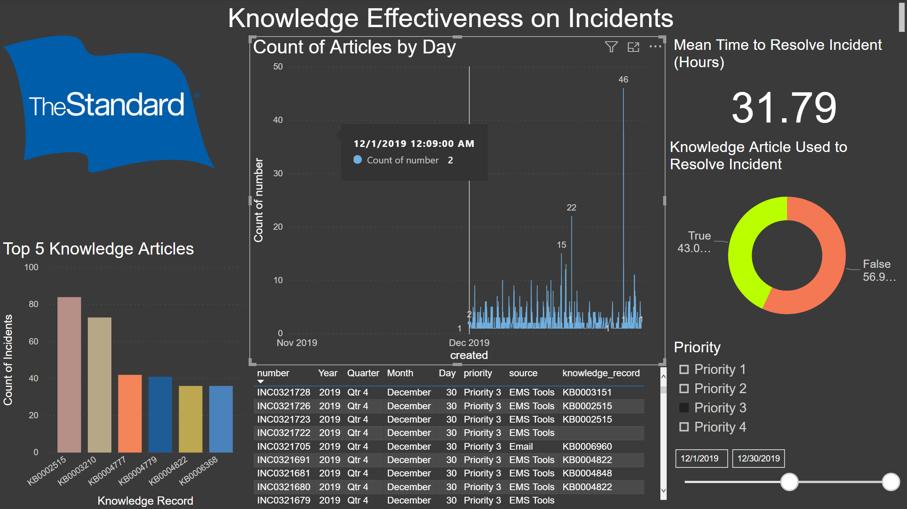
Demo Scenario
Slicers
Pick “Priority 3” and move the slider to only include the December data.

Slide 12
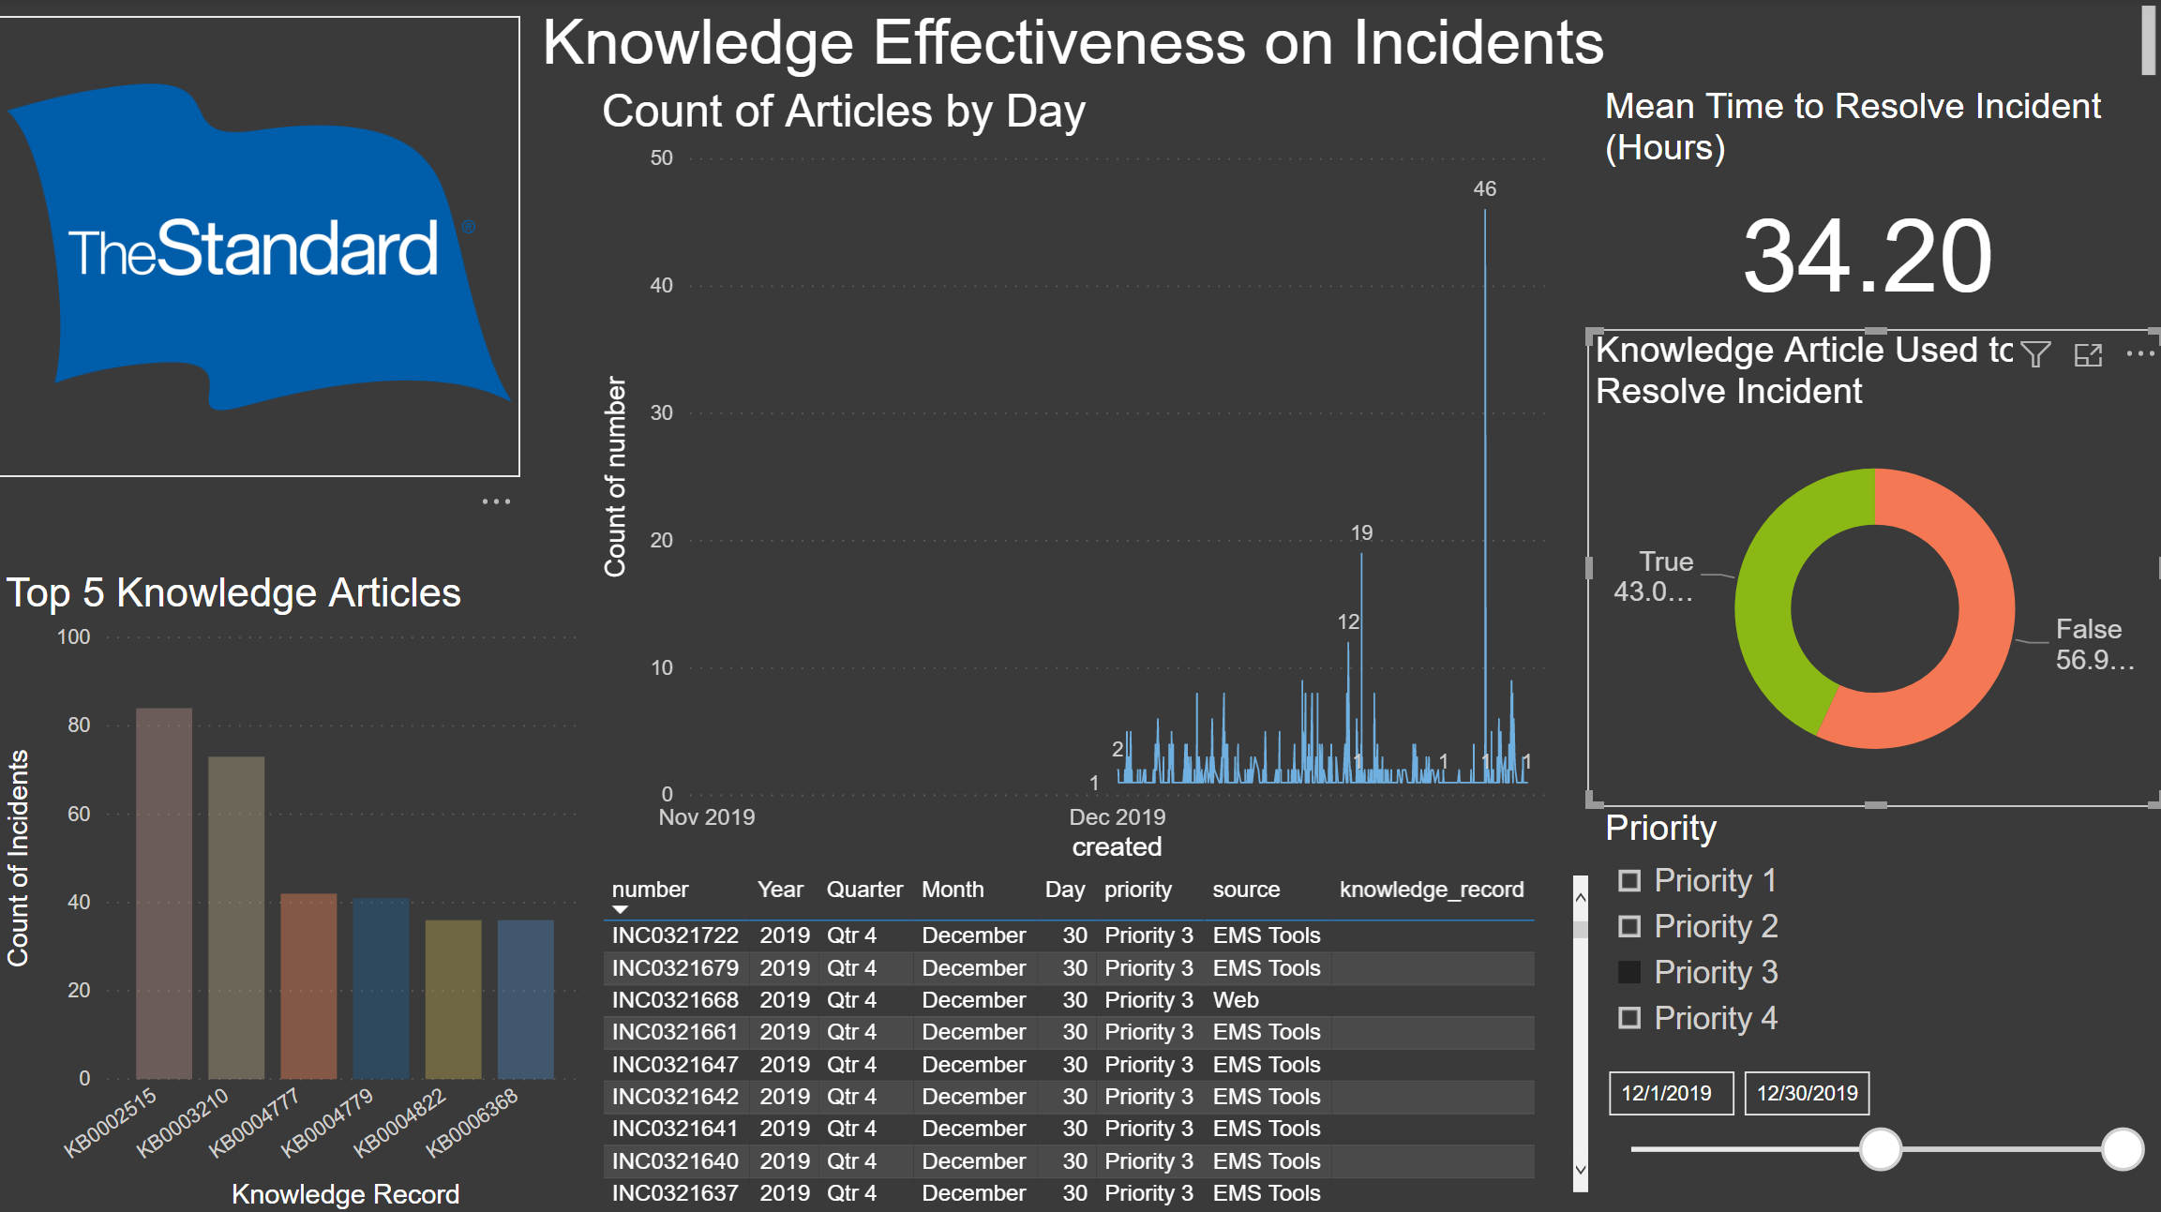
Demo Scenario
Donut
Select false on the donut and look at the MTTR card.
Keep in mind the number
34.20 hours

Slide 13
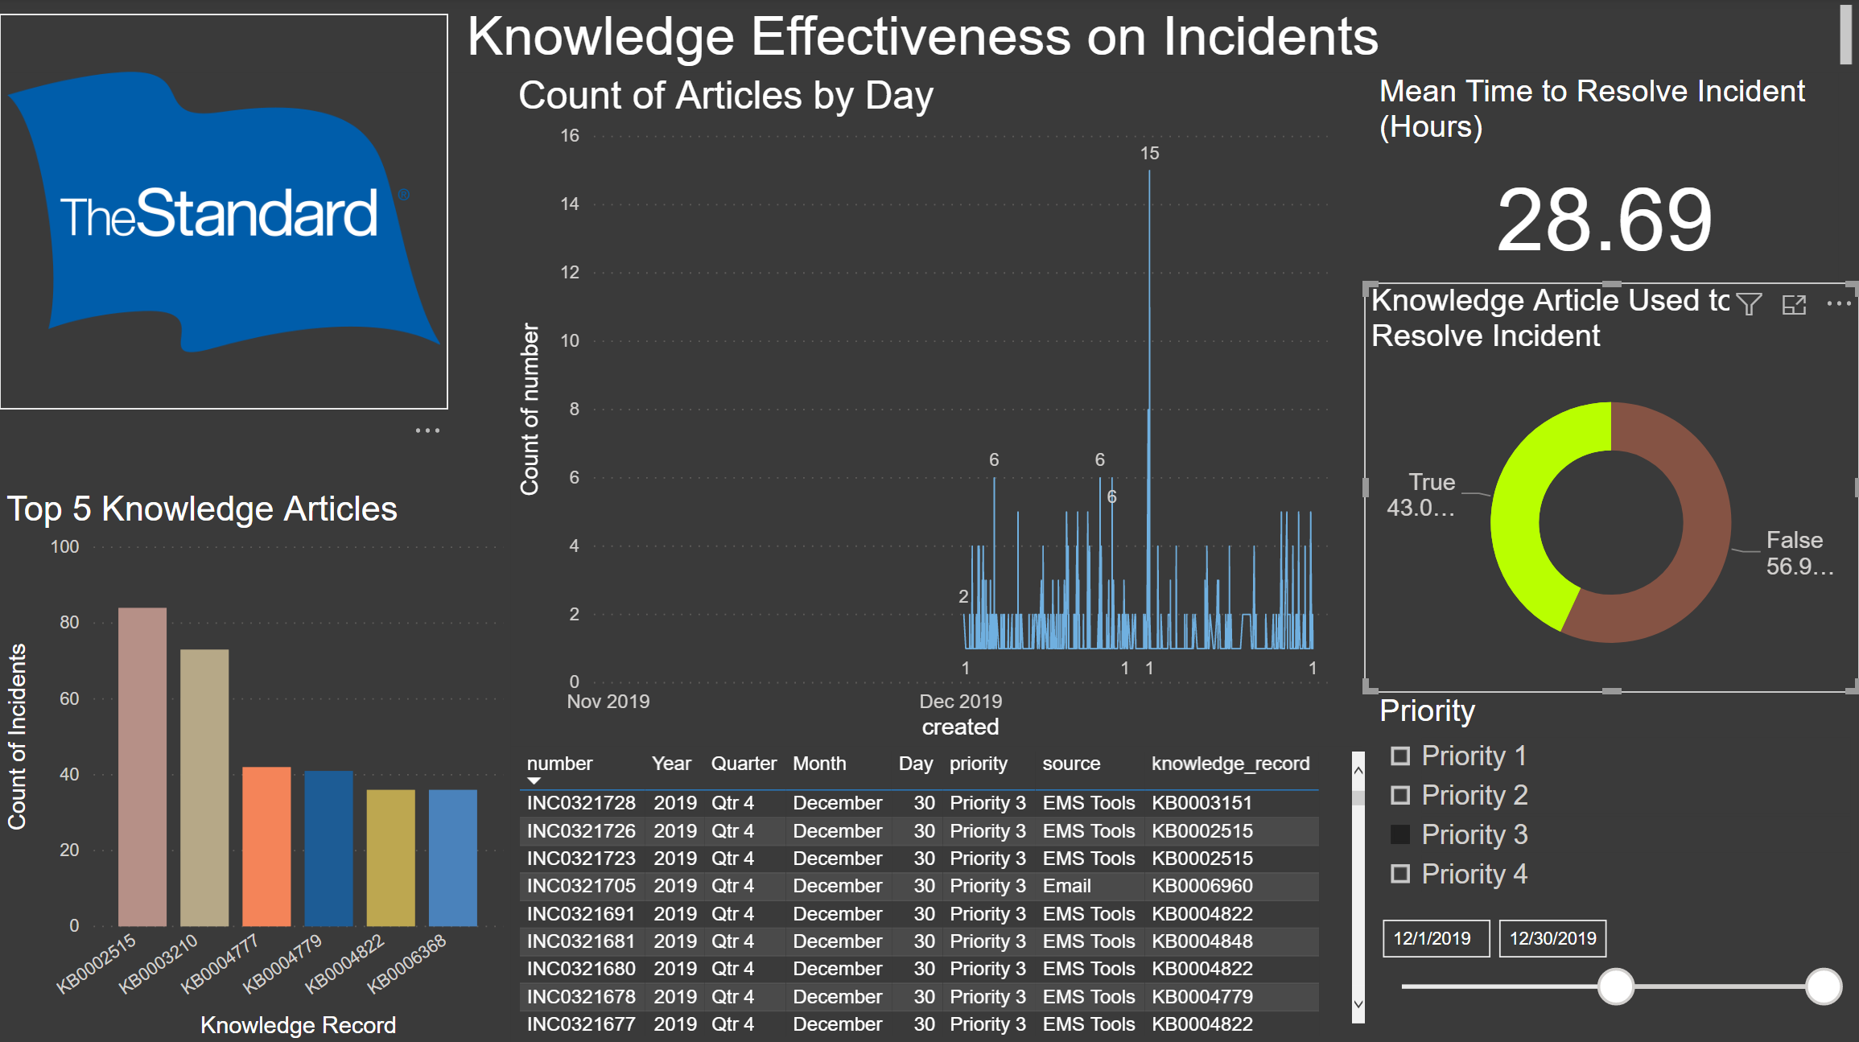
Demo Scenario
Donut
Select true on the donut and look at the MTTR card.
Keep in mind the number
28.69 hours!!

Slide 14
Data Conclusion
We saw that when knowledge was being used for P3 incidents that our MTTR was about 5 hours less!
This is helpful for management, because they know the quality of their article is probably decent and is having a good impact on the incidents.
Knowing it is having this impact since they saw only about half of the Incidents were resolved using knowledge they might want to focus on that other 50% to either provide useful knowledge for resolution or encourage agents to check the knowledge base to find help for resolving the incident.
Conclusion: Knowledge is working to drive down MTTR!

Slide 15
Lessons Learned
Database Failure: I was using a resource in the beginning that turned out to be bad. The servers kept getting overloaded and I had to move my data halfway through.
PowerBI: It didn’t come out of the box with being able to work with MYSQL so I needed to install additional plugins.
I really think PowerBI is a fantastic tool and I love the constant interactiveness of the dashboard.

Slide 16
Conclusion
It was a fun project and I learned a lot about visualization. I learned as well that it is important to keeps things simple so that it is easy to draw conclusions from your visualizations especially if you have a lot going on, on the page.

Slide 17
THANKS!

